Slide 1
Chapter Two
Essential Enterprise Development Technologies

Slide 2
Chapter outline
Java Enterprise Edition
Java EE platform
Java EE application architecture
Java EE Server
Understanding Web server
Port Number, Log file
Undrstanding Containers (Tomcat)
Development tools
JDK, IDE, Build Automation Tool, web container …

Slide 3
Introducing Java Enterprise Edition (JEE)

Slide 4
The context
We are in the situation of developing a complex, large-scale, portable, scalable, reliable, secure, transactional, distributed system.
Who is the customer?
A HUGE bank, a chain of hypermarkets, a Fortune 500 company, etc.
What do we know?
Programming language : Java, C++, python, JavaScript
Various protocols: TCP, UDP, HTTP, SOAP, etc.
What do we want?
A framework that will make our lives as easy as possible.

Slide 5
Java enterprise edition (java ee)
The answer is Java EE

Slide 6
Java Enterprise Edition (Java EE)
What is java EE ?
Short for Java Enterprise Edition
Java EE is a platform-independent, Java-centric environment from Sun/Oracle for developing, building and deploying Web-based enterprise applications online.
The Java EE consists of a set of services, APIs, and protocols that provide the functionality for developing multi-tiered, Web-based applications.

Slide 7
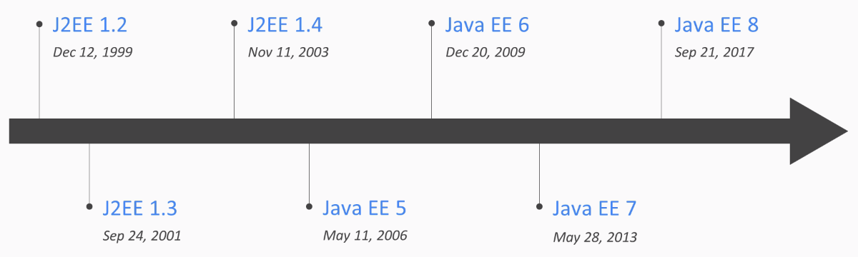
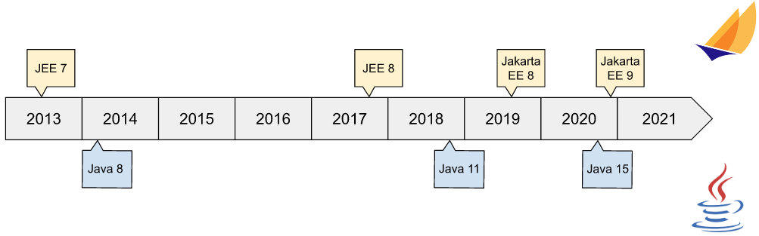
J2EE to Jakarta EE
J2EE (1999) 1.2, 1.3, 1.4;
Java EE (2006) 5, 6, 7, 8
In 2017, Oracle decided to give away the rights for Java EE to the Eclipse Foundation.
Jakarta EE (2021) 8,9,9.1

Slide 8
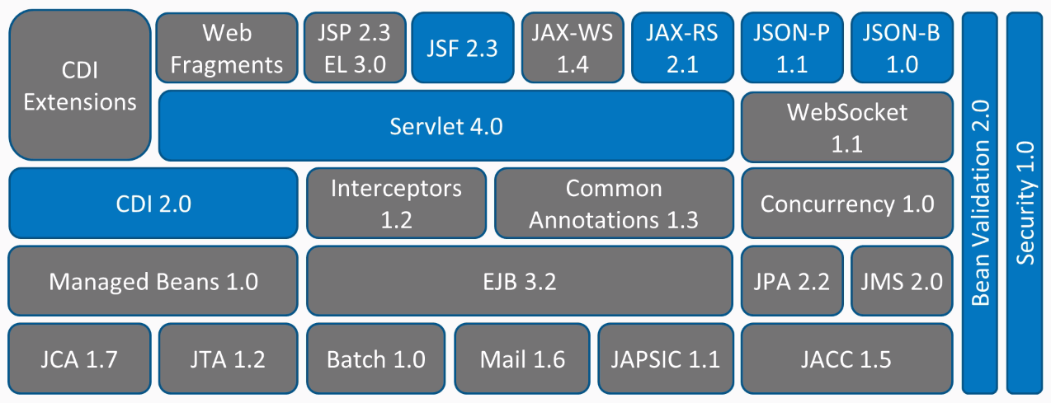
Java EE

Slide 9
Java EE
The Java EE platform is built on top of the Java SE platform.
The Java EE platform provides an API and runtime environment for developing and running
large-scale
multi-tiered
scalable
Reliable
secure network applications

Slide 10
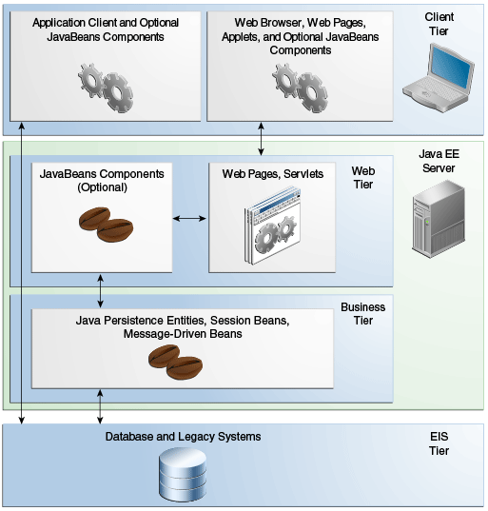
Java EE Application
The Java EE platform uses a distributed multitiered application model for enterprise applications.
Application logic is divided into components according to function.
The application components that make up a Java EE application are installed on various machines depending on the tier in the multitiered Java EE environment to which the application component belongs.

Slide 11
Advantages of using Java EE in Enterprise
Java can run on multi-platform (WORA)
Object Oriented design for system architecture
Plenty of framework for system building
Wide dissemination with minimal cost
Dominating the e-Commerce industry
FOSS (free and open source software)

Slide 12
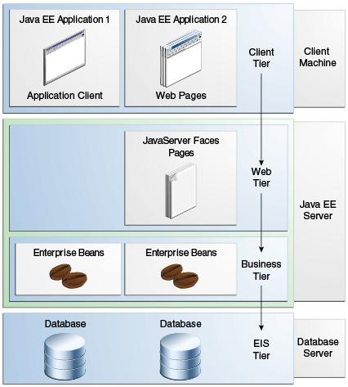
Java EE Application
In a classic web-based Java EE application architecture, there are four tiers:
Client Tier
Web Tier
Business Logic Tier
Enterprise Information System (EIS)

Slide 13
Java EE Application Tiers
Client tier
The client tier is usually a browser for rendering the user interface on the end-user machines, or an applet embedded in a web page.
Web tier
The web tier components run inside an application server and generate HTML or other markup that can be rendered or consumed by components in the client tier. This tier can also serve non-interactive clients such as other enterprise systems (both internal and external) via protocols such as Simple Object Access Protocol (SOAP) or Representational State Transfer (REST) web services.

Slide 14
Java EE Application Tiers cont.
Business logic tier
The components in the business logic tier contain the core business logic for the application. These are usually a mix of Enterprise Java Beans (EJB), Plain Old Java Objects (POJO), Entity Beans, Message Driven Beans, and Data Access Objects (DAO), which interface with persistent storage systems such as RDBMS, LDAP, and others.
Enterprise information systems (EIS) tier
Many enterprise applications store and manipulate persistent data that is consumed by multiple systems and applications within an organization. Examples are relational database management systems (RDBMS), Lightweight Directory Access Protocol (LDAP) directory services, NoSQL databases, in-memory databases, mainframes, or other back-end systems that store and manage an organization's data securely.

Slide 15
The components in each tier
Client Tier (Font End)
Web application, application clients, applets
Web Tier
Java servlet: Java servlets are server side modules, typically used to process a request and send back response in the web applications.
Java Server Pages (JSP): JSPs are also server side modules used to process the web requests. JSPs (Java Server Pages) are great for handling requests that generate large HTML markup responses
Java Server Faces; Java Server Faces makes creating user interface on the server side modular by incorporating the MVC design pattern in its implementation.

Slide 16
The technologies in each tier cont.
Business logic tier
Enterprise Java Beans (EJB): are the Java classes where you can write your business logic.
EJB are two types:
Session beans: Session beans are called directly by clients or middle tier objects
Message driven beans (MDB): Message driven beans are called in response to Java Messaging Service (JSM) events

Slide 17
The components in each tier cont.
Enterprise information systems (EIS) tier
Java Database Connectivity (JDBC): JDBC is a specification to access relational database in a common and consistent way.
The Java Persistent API (JPA):JPA gives you the flexibility to map the objects to the tables in relational database and execute the queries with or without using Structured Query Language (SQL).
Web services: Web services are remote application components that expose self-contained APIs.
Simple Object Access Protocol (SOAP)
Representational State Transfer (REST)

Slide 18
Common Multi-tier Applications
The Java EE specification is designed to accommodate many different types of multi-tier applications. Some of the most common ones are briefly highlighted:
Web-centric architecture
Combined Web and Business Logic Component-based Architecture
Business-to-Business Architecture (B2B)
Web Service Application Architecture

Slide 19
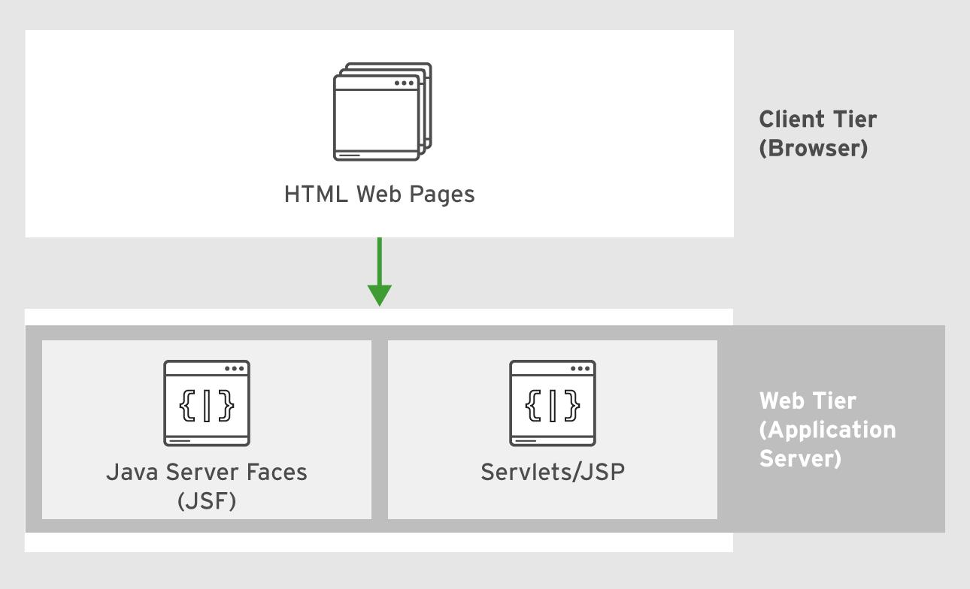
Web-centric architecture
This type of architecture is for simple applications with a browser- based front end and a simple back end powered by Servlets, Java Server Pages (JSP), or Java Server Faces (JSF). Features such as transactions, asynchronous messaging, and database access are not used.

Slide 20
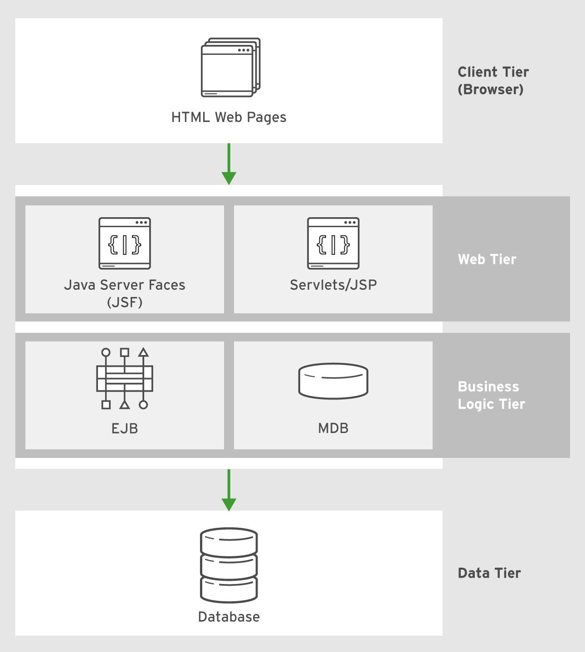
Combined Web and Business Logic Component-based Architecture
a browser in the client tier interfaces with a web tier.
web tier consisting of Servlets, JSPs, or JSF pages, which are responsible for rendering the user interface, controlling page flow, and security

Slide 21
Combined Web and Business Logic Component-based Architecture cont.
The core business logic is hosted in a separate business logic tier, which has Java EE components such as EJBs, Entity Beans (JPA), and Message Driven Beans (MDB).
Enterprise information systems (EIS) tier such as relational databases and back-office applications that expose an API for managing persistent data, and provide transactional capabilities for the application

Slide 22
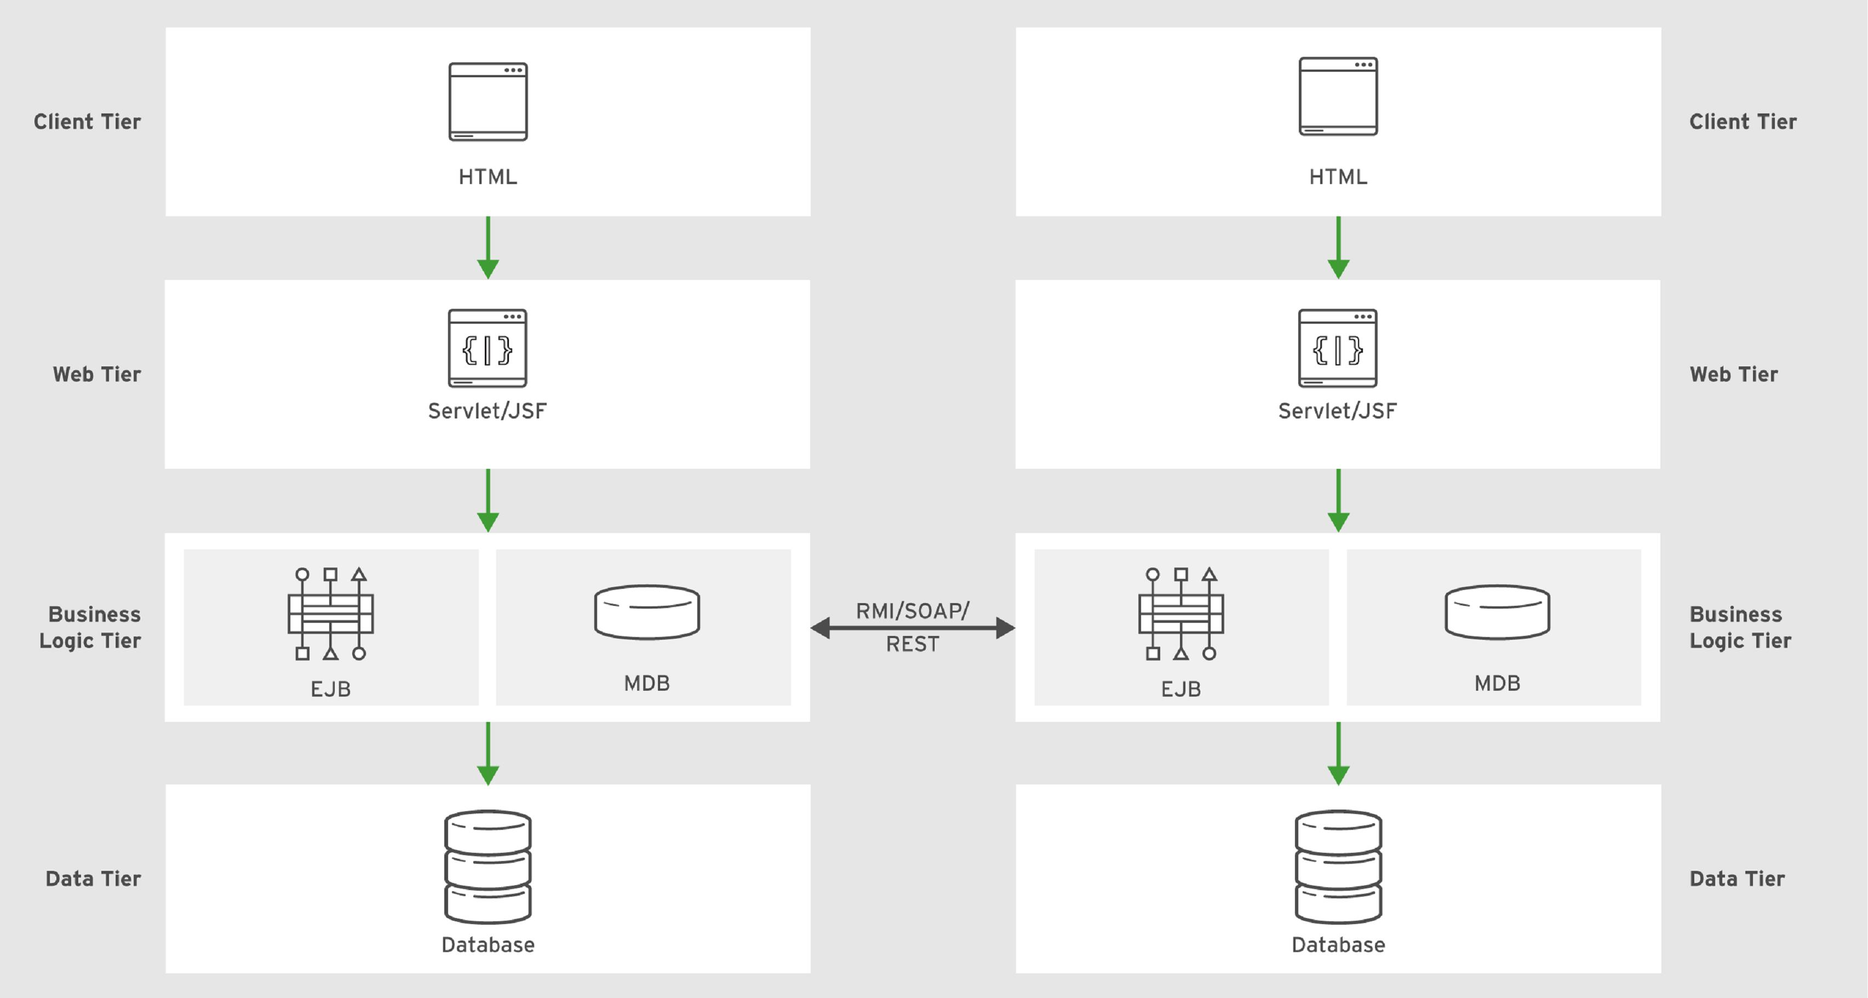
Business-to-Business Architecture (B2B)
In this type of architecture, the front end is usually not an interactive graphical user interface (GUI) that is accessed by end users, but an internal or external system that integrates with the application and exchanges data using a mutually understood standard protocol such as Remote Method Invocation (RMI), HTTP, Simple Object Access Protocol (SOAP), or Representational State Transfer (REST).

Slide 23
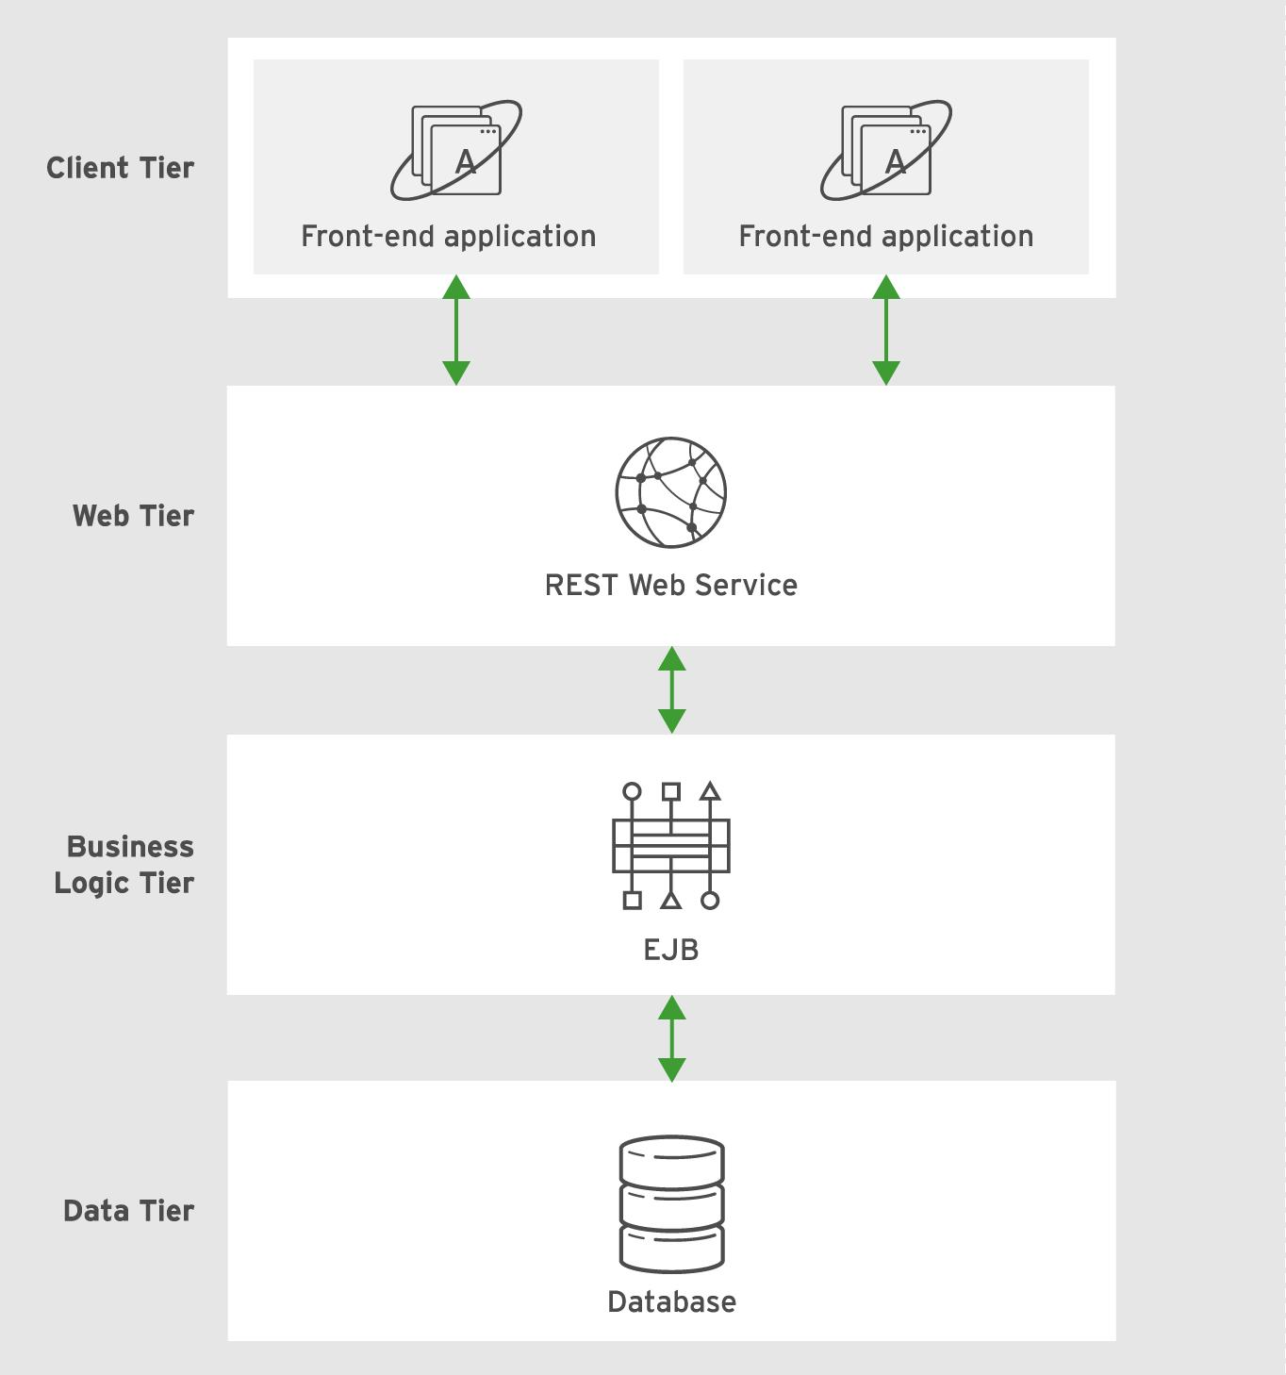
Web Service Application Architecture
In this architecture, the application provides an API that is accessed over an HTTP-based protocol such as SOAP or REST via a set of services (endpoints) corresponding to the business function of the application. These services are consumed by non-interactive applications (can be internal or third-party) or an interactive HTML/JavaScript front end using frameworks such as AngularJS, Backbone.js, React, and many more.

Slide 24
Java EE server
Web Server

Slide 25
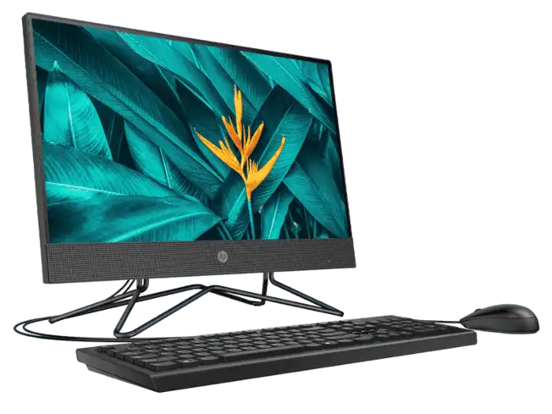
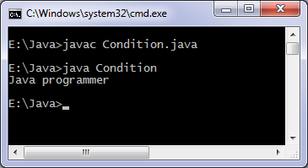
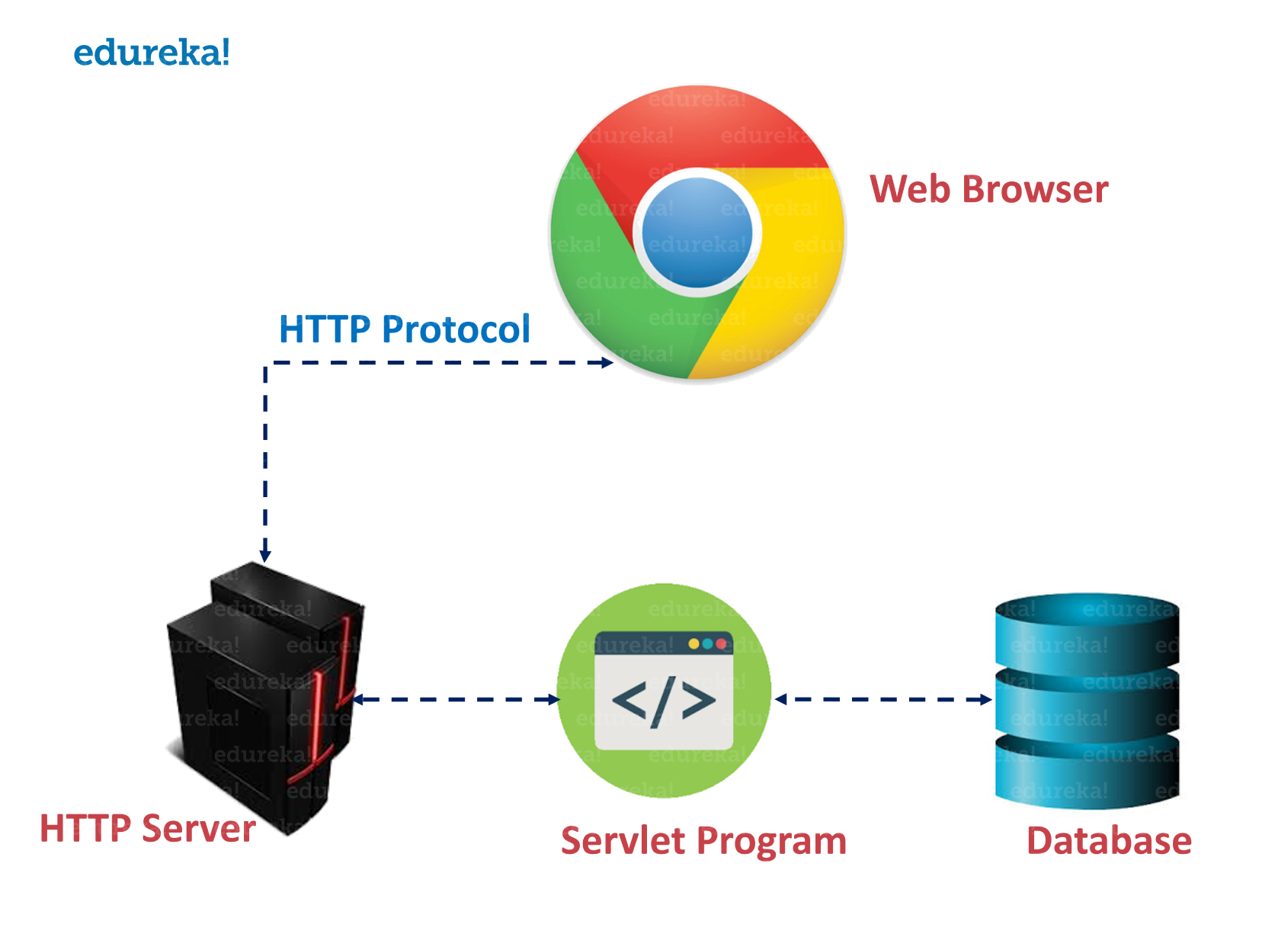
Web Server
Standalone Java Application: (Java SE)
Run on local machine
Main function as entry point
Compile to class or jar file
Java Enterprise Web Application: (Java EE)
Run on Java EE Server
Without main function
Packaging to war or ear file format.

Slide 26
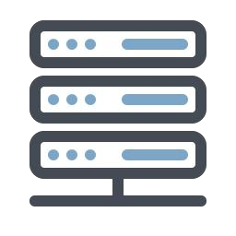

Web server
A web server is server software, or hardware dedicated to running this software, that can satisfy client requests on the World Wide Web.
A web server can, in general, contain one or more websites.
A web server processes incoming network requests over HTTP.
Web server can refer to hardware or software, or both of them working together.
On the hardware side, a web server is a computer that stores web server software and a website's component files.
On the software side, a web server includes several parts that control how web users access hosted files.

Slide 27



Web server
The web server
figures out which
page to return for
that URL
3
The web server
give your browser a
page full of HTML,
CSS and JavaScript
you open up a web
browser and type in
a URL
4
1
2
Sent a
REQUEST
The web server
displays the web
page.
6
5
Sent a
RESPONSE

Slide 28
Web server
Handle static web contents with HTTP protocol
It processes the HTTP Request and Response to deliver static web contents (e.g. web pages, images, documents, etc.).
It doesn’t process the server-side programs (PHP, .NET, Java, etc.) to deliver dynamic web contents.
Use port 80 to provide services in general
It reserves this port to provide HTTP services as default.
Once it is started, you cannot run other services to use the same port.

Slide 29


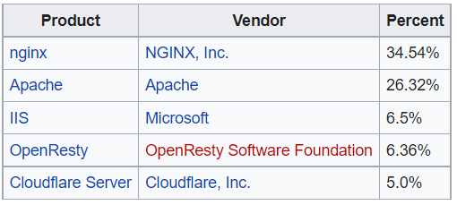



February 2021
Below are the latest statistics of the market share of all sites of the top web servers on the Internet by Netcraft February 2021 Web Server Survey
https://en.wikipedia.org/wiki/Web_server#Market_share

Slide 30

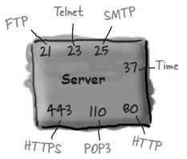
Port Numbers
Ports are commonly used by network programming for two points to communicate.
Servers reserve a port number to provide services for their clients. So, clients can talk to the server through this port.
Internet socket port number consists of a 16-bit number (0 to 65,535).
Port numbers from 0 to 1,023 are reserved for well-known services.
Port Number List
http://en.wikipedia.org/wiki/List_of_TCP_and_UDP_port_numbers

Slide 31
Commonly used Ports
Reserved Ports
Official: FTP (20, 21), SSH (22), Telnet (23), SMTP (25), HTTP (80), POP3 (110), LDAP (389), HTTPS (443), etc.
Software Products: MySQL (3306), PostgreSQL (5432), Apache Application Server (8080), IBM WebSphere (9080), etc.
Different software may use the same port (8080), so checks the default setting before starting a service.

Slide 32
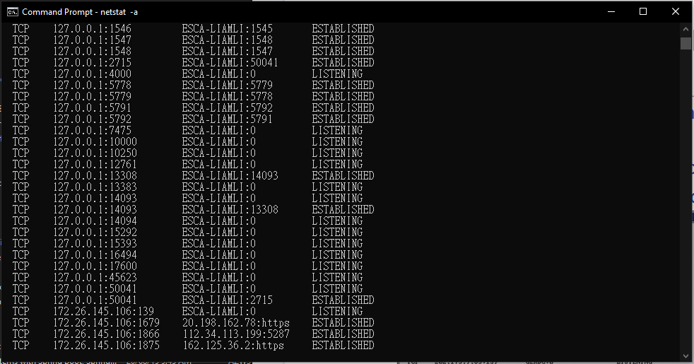
Multiport Single Server (MPSS)
People often use the all-in-one approach to have all server components set up in a single machine.
Each server component reserves a port to provide services.
Use netstat command to check the usage of ports:

Slide 33
Log Files
A very important channel for systems to report human.
Always the first check point for system faults, illegal operations, transactional exceptions, etc.
One of the maintenance strategies for keeping the system healthy is to keep your log quiet (handle all the exceptions and stop throwing the unnecessary messages)
Generally, there are three content levels for logging:
System Log, Application Log, and User Access Log
Generally, there are three approaches to manage the log files:
Continuity, Schedule, and Cycle
Log files contain critical information, and strategic policies are often established by studying them in deep.

Slide 34
Content level
System Log
Report the server resources: CPU, memory, disk space, and other OS level service status.
Application Log
Report the application server status: program error messages, transactional information, server operational (startup, shutdown, update, etc.) messages, database connection usage, etc.
User Access Log
Report the user activities: user visited pages, visit time, amount of data transferred, words searched, and other visitor’s information (Locale, IP address, device, browser version, etc.).

Slide 35
Managing the Log
Disk space is limited, we can’t let the log files to grow without any control.
Most of the servers will provide the following ways to manage their log files:
continuity, schedule, cycle
Continuity Approach
Found in most of the servers as the default setting.
Do not rollover and keep appending the content in a single file.
Suitable for small size web applications.
However, keep reading and writing a very large file may lower the server performance.

Slide 36
Managing the Log (cont.)
Schedule Approach
Most reasonable approach to keep logs in a timely basis.
Rotate the log files on a daily basis (eg. 20180901sys.log, 20180902sys.log, 20180903sys.log, etc.).
Some very busy servers may keep their logs on an hourly basis (eg. 20180901_11sys.log, 20180901_12sys.log, 20180901_13sys.log, etc.).
Cycle Approach
Rewrite the log file when it is older or larger than a certain value.
Set the maximum file size for the log to rewrite (eg. Renew when the file size is equal to or larger than 1G).
Set the maximum date/time for the log to keep before rewrite (eg. Renew on every Sunday, renew on every 00:00:00, renew when it is older than 72 hours, etc.).

Slide 37
Java EE server
Application Server, Containers

Slide 38
Application Server
An application server is a server that hosts applications.
Application servers are system software upon which web applications or desktop applications
Application servers consist of
web server connectors,
computer programming languages,
runtime libraries,
database connectors,
and the administration code needed to deploy, configure, manage, and connect these components on a web host.
An application server runs behind a web server and (almost always) in front of a database.

Slide 39
Java application server
Java EE defines the core set of API and features of Java Application Servers.
The Java EE infrastructure is partitioned into logical containers.
EJB container: Enterprise JavaBeans (EJB) are used to manage transactions. According to the J2EE blueprints, the business logic of an application resides in Enterprise JavaBeans—a modular server component providing many features, including declarative transaction management, and improving application scalability.
Web container: The Web modules include servlets and Java Server Pages (JSP).
JCA container (Java EE Connector Architecture)
JMS provider (Java Message Service)

Slide 40
the key differences between the two types of servers
Web Server
Deliver static content.
content is delivered using the HTTP protocol only.
Serves only web-based applications.
No support for multithreading
Facilitates web traffic that is not very resource intensive.
Application Server
Delivers dynamic content.
provides business logic to application programs using seral protocols.
Can serve web and enterprise-based applications.
uses multi-threading
Facilitates longer running processes that are very resource-intensive

Slide 41
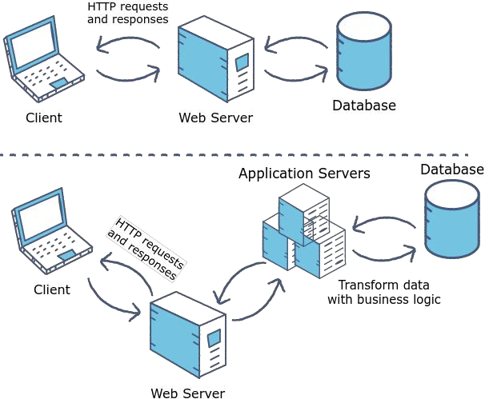

Slide 42
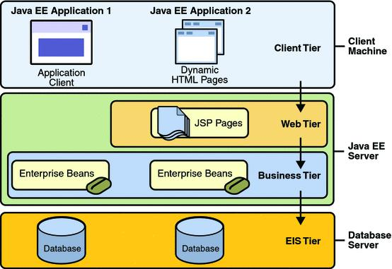
Containers
“Containers are the interface between a component and the low-level platform-specific functionality that supports the component.
Before a web, enterprise bean, or application client component can be executed, it must be assembled into a Java EE module and deployed into its container.”

Slide 43
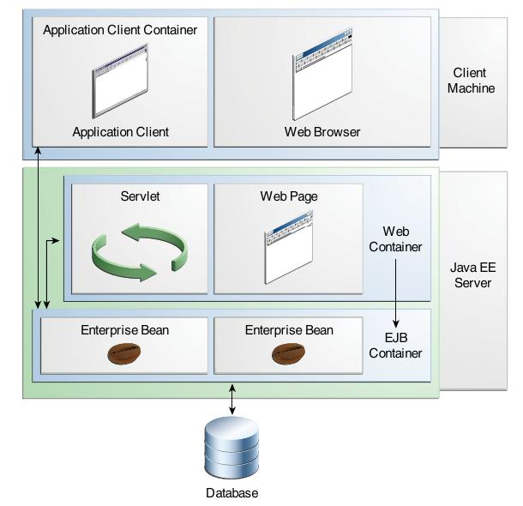
Container types
Web container: Manages the execution of web pages, Java servlets, JSP and some EJB components for Java EE applications. Web components and their container run on the Java EE server.
EJB container: Manages the execution of enterprise java beans for Java EE applications.

Slide 44
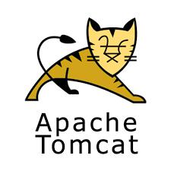
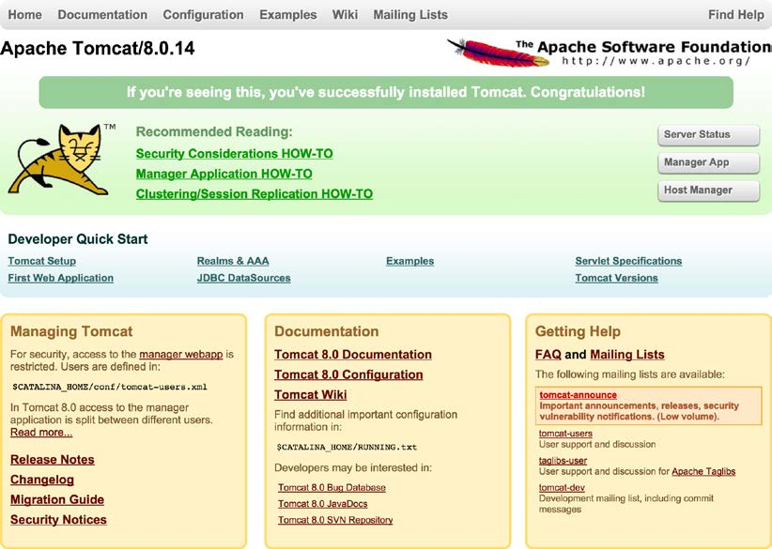
Java web container
A web container is the component of a web server that interacts with Java servlets. A web container manages the life cycle of servlets; it maps a URL to a particular servlet while ensuring that the requester has relevant access-rights.
Apache Tomcat is the most common and popular web container and it will be used throughout this course.
http://tomcat.apache.org/tomcat-8.5-doc/index.html
http://tomcat.apache.org/download-85.cgi

Slide 45

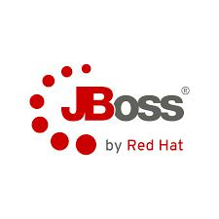

Other Java application server
Glassfish is an open source and commercial full Java EE application server implementation. It provides all the features in the Java EE specification, including a web container.
WildFly/JBoss AS is an open source and free full Java EE application server implementation.

Slide 46
Enterprise development tools
JDK, IDE, Tomcat ...

Slide 47
Java Development tools
Software Development Kit (SDK): A SDK is a collection of software development tools in one installable package.
JDK:
Integrated development environment (IDE): An IDE is a software for building applications that combines common developer tools into a single graphical user interface (GUI).
Eclipse
Build Automation: Build automation is a process of automating the creation of a software build and the associated processes including: compiling, packaging and running automated tests.
Maven
Test Automation: Test automation is the use of software separate from the software being tested to control the execution of tests and the comparison of actual outcomes with predicted outcomes.
Junit

Slide 48
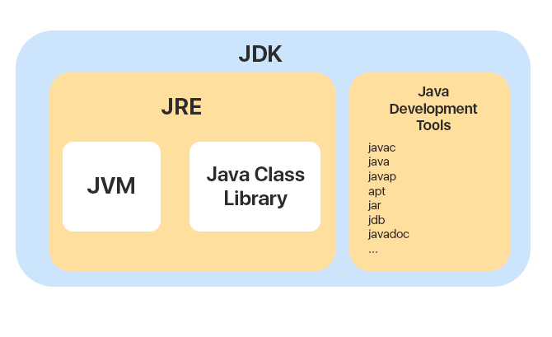
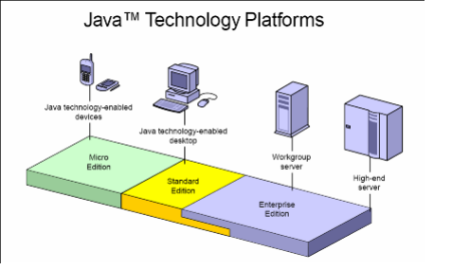
Java development kit (JDK)
The Java Development Kit (JDK) is one of three core technology packages used in Java programming. (JDK, JRE, JVM)
The JVM is the Java platform component that executes programs
The JRE is the on-disk part of Java that creates the JVM.
The JDK allows developers to create Java programs that can be executed and run by the JVM and JRE.

Slide 49
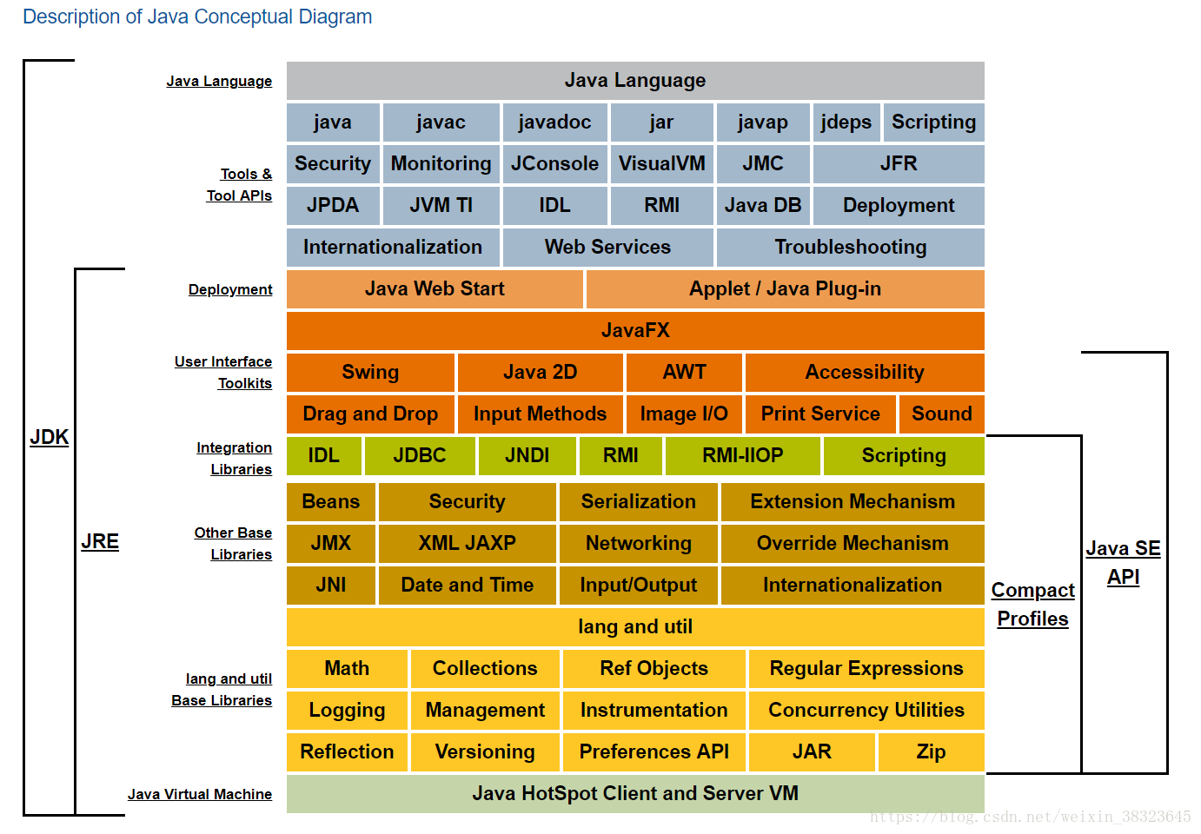

Slide 50
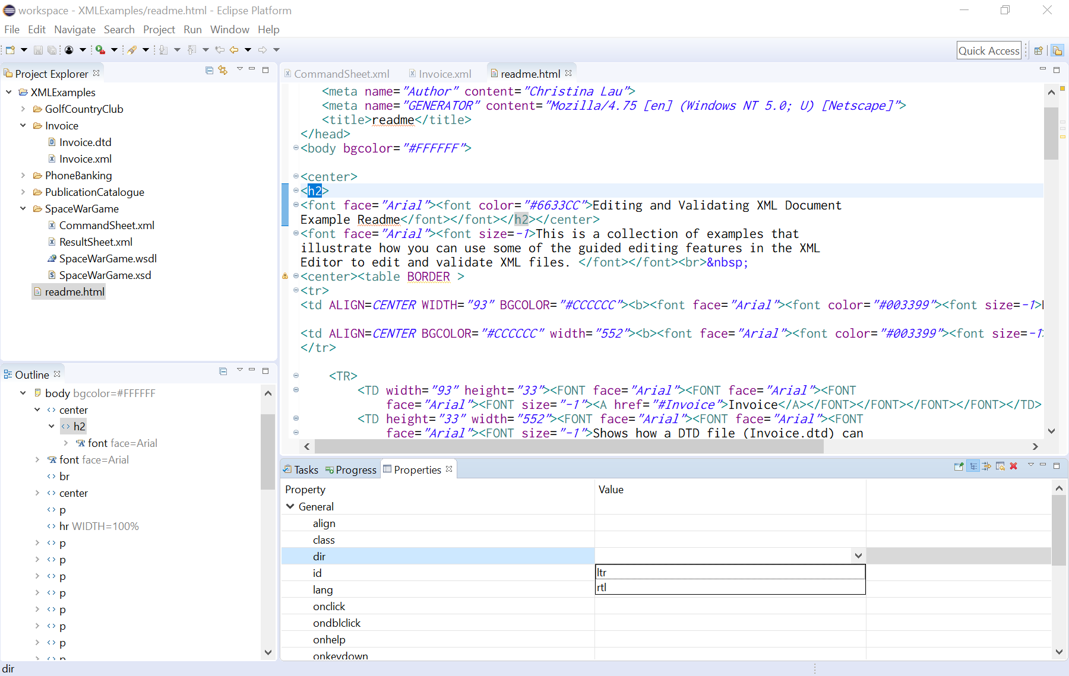

Integrated development environment (IDE)
An integrated development environment (IDE) is software for building applications that combines common developer tools into a single graphical user interface (GUI).

Slide 51
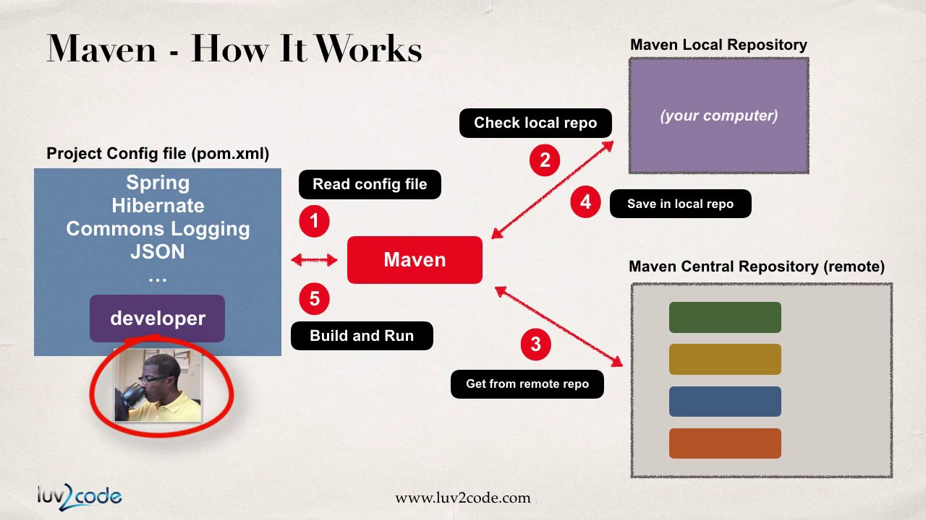
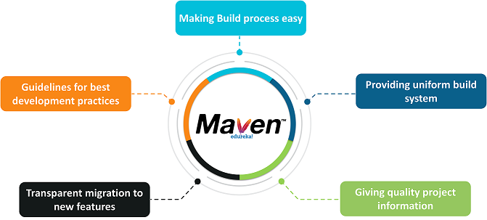
Build automation tool
Build automation is the process of automating the creation of a software build and the associated processes including: compiling computer source code into binary code, packaging binary code, and running automated tests.

Slide 52
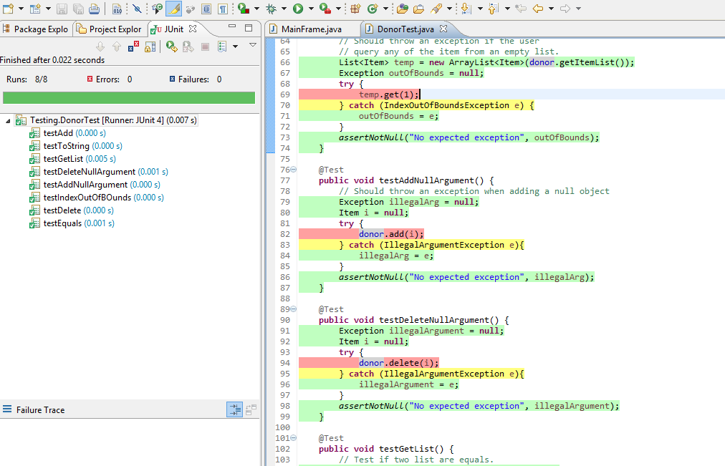

Test Automation
Test automation is the use of software separate from the software being tested to control the execution of tests and the comparison of actual outcomes with predicted outcomes.

Slide 53
Home Exercise
Download and Install JDK on your machine
Install an Eclipse IDE on your machine
Install Tomcat 8.5
Eclipse configurate tomcat
Install MySQL

